Slide 1
Bhojan An online food ordering system
Basudev Neupane
(Reg.no: 6-2-1133-44-2019)
Bikal Adhikari
(Reg.no: 6-2-1133-47-2019) 4th semester, BCA

Slide 2
1. Introduction
Bhojan is the website where you can order any fast food like Momo, Pizza, Chowmin, Chaat and so on.
It will provide fast food service to customer without physically going to restaurants which simplifies the ordering process for both the customer and restaurant.

Slide 3
2. Problem of Statement
Customer must come to a restaurant and order manually.
Customers will have to make long queues before placing their orders
Having placed their order, the customer must then wait near the counter until their order is ready for collection.
In recent pandemic people couldn’t go outside and enjoy food.

Slide 4
3. Objectives
To save customer time and effort for coming restaurant.
To increase efficiency and improve services provided to the customers using technology.
To reduce restaurant’s food wastage.
To be able to stand out from competitors in the food service industry.

Slide 5
4. Technical Feasibility
Our system is technically feasible because:
It is within the limits of current technology.
Required software and hardware is easily available.
There are enough manpower-programmers, testers and debuggers.

Slide 6
5. Operational Feasibility
Our system is operationally feasible because:
It works within the government regulations.
It make efficient use of available resources.
To operate this system customer only needs web browser and internet connectivity.

Slide 7
6. Economical Feasibility
Our system is economically feasible because:
Our system’s hardware and software cost less.
Cost of business employee time is also average.
It automatically performs most task intelligently that helps to save the manpower cost.

Slide 8
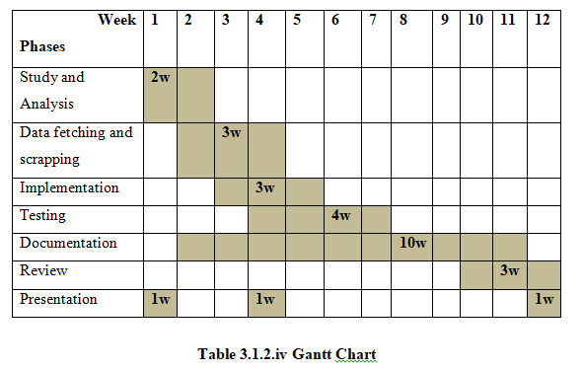
7. Time Framework

Slide 9
8. Requirement Analysis
8.1 Functional Requirement
Admin needs to control the database and keep track of records of all customers.
Customers can create account, login, view available food items and place order and contact with us for any suggestions.

Slide 10
8.2 Non-Functional Requirement
Easy to maintain
Secure
Fast response
Easy to use
Reliable

Slide 11
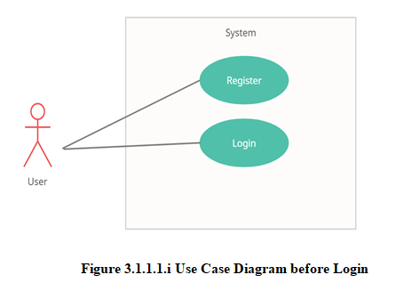
9. System Analysis

Slide 12
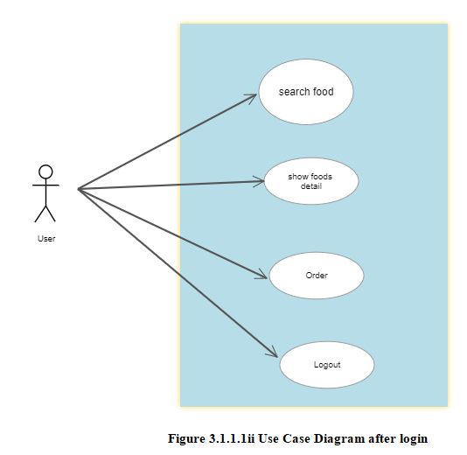

Slide 13
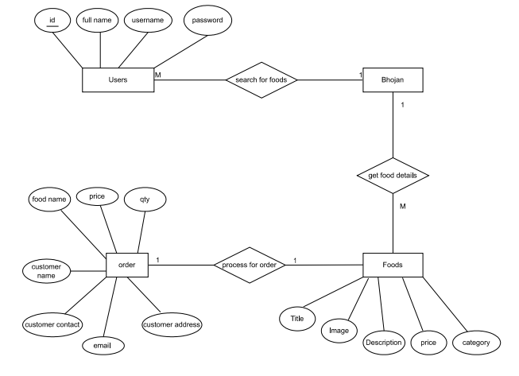
Figure 3.1.3 ER Diagram

Slide 14
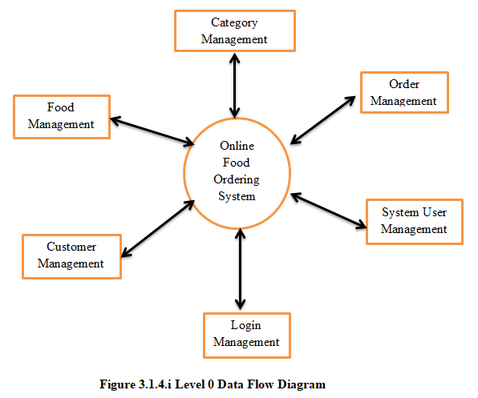

Slide 15
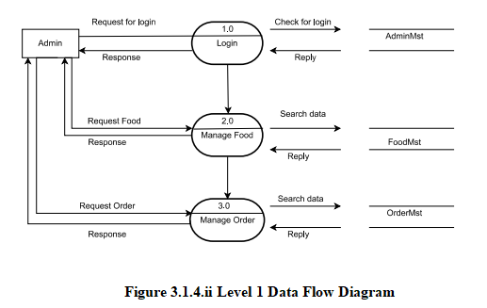

Slide 16
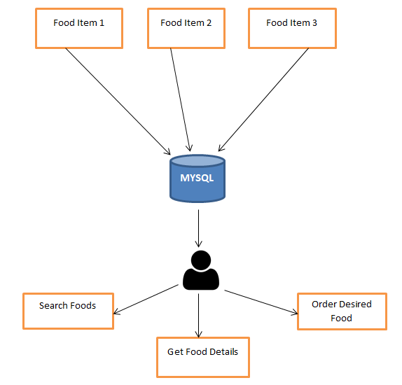
Figure 3.2.1 Architecture Design

Slide 17
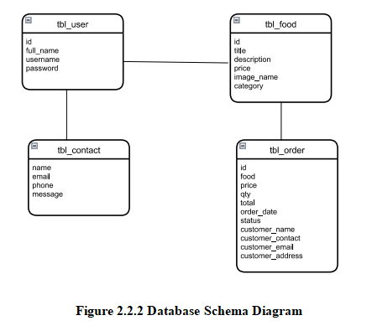

Slide 18
10. Conclusion
Our system will save a lot of time and effort and provide best, unique experience to customers.
Hence we have conclude that this project can be beneficial in daily life of people.

Slide 19
--Thank You--

